Slide 1
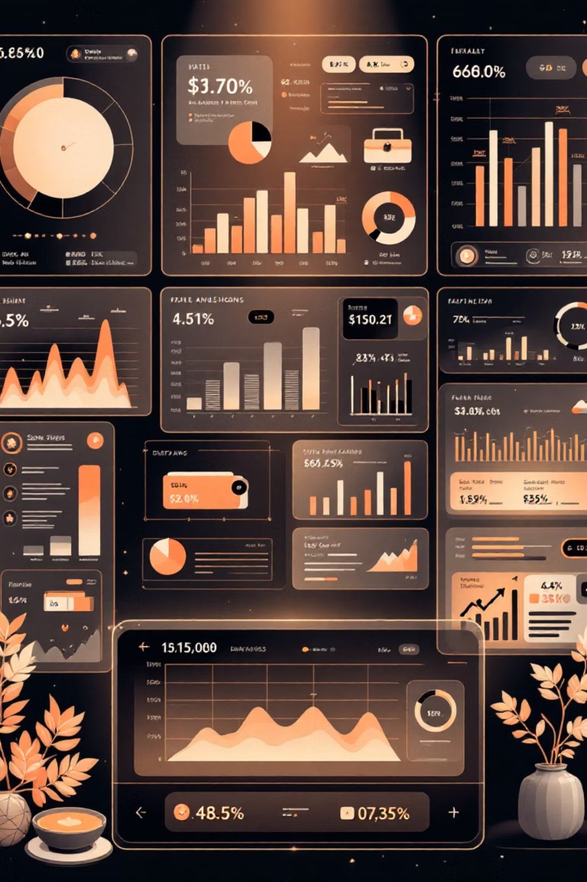
Customer Shopping Behavior Analysis
Uncovering insights from 3,900 purchases to guide strategic business decisions

Slide 2
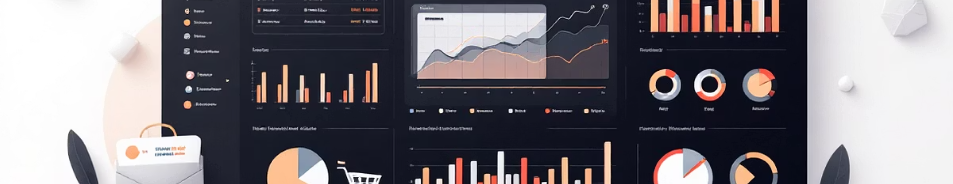
Dataset Overview
3,900
18
50
25
Total Purchases
Data Points
Locations
Products
Transactions analyzed
Features per purchase
Geographic coverage
Items tracked

Slide 3

Data Preparation Journey
01
Data Loading
Imported dataset using pandas, explored structure with df.info()
02
Missing Data Handling
Imputed 37 missing Review Ratings using median by category
03
Feature Engineering
Created age_group and purchase_frequency_days columns
04
Database Integration
Connected to PostgreSQL for advanced SQL analysis

Slide 4
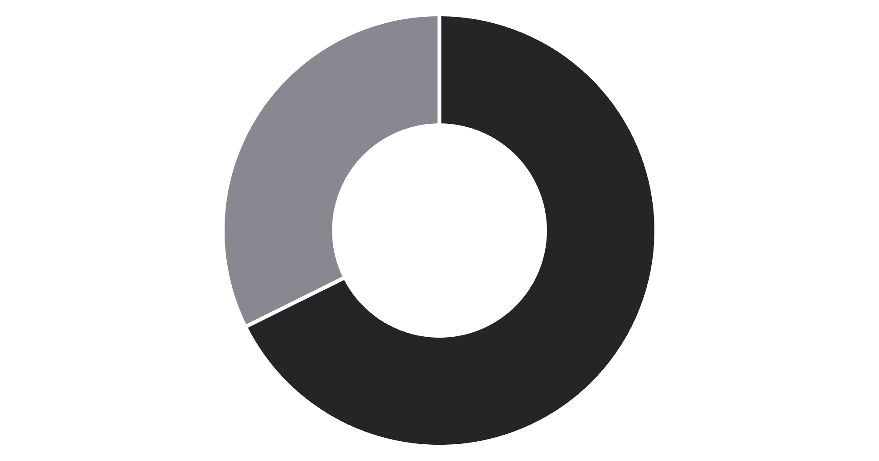
Revenue by Gender
Key Finding
Male customers generate 68% of total revenue
Female segment shows opportunity for targeted growth campaigns
Male
Female

Slide 5
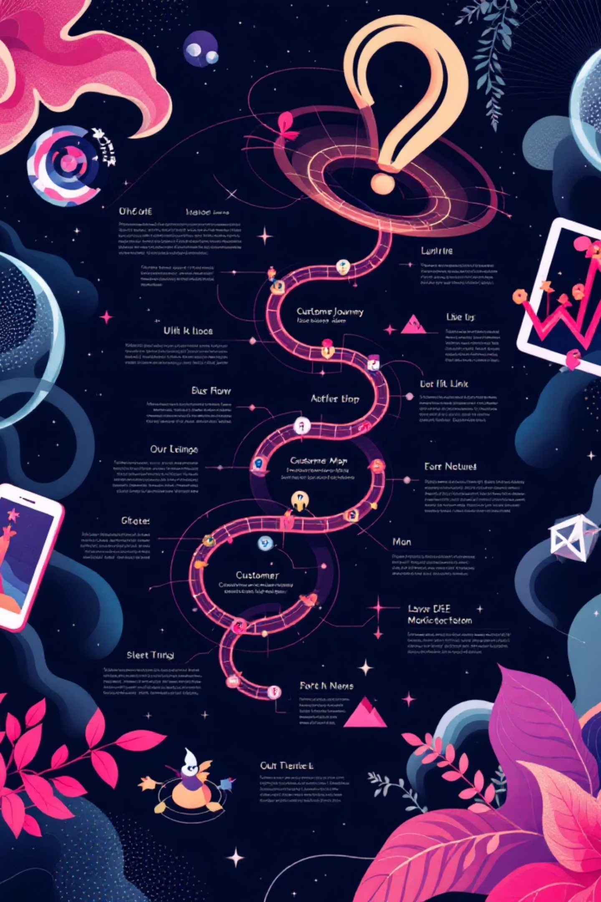
Customer Segmentation Insights
Loyal Customers
Returning Buyers
3,116 customers
701 customers
Largest segment driving repeat business
Growth opportunity segment
New Customers
83 customers
Smallest segment needing nurture
958 repeat buyers (>5 purchases) have subscriptions vs. 2,518 without

Slide 6
Top Performing Products
Gloves
Sandals
Boots
Highest rating: 3.86 stars
Rating: 3.84 stars
Rating: 3.82 stars
Category Leaders
Discount Dependent
Clothing: Blouse (171 orders)
Hat leads with 50% discount rate, followed by Sneakers at 49.66%
Accessories: Jewelry (171 orders)
Footwear: Sandals (160 orders)

Slide 7


Subscription vs. Non-Subscription
Subscribers
1,053 customers
Average spend: $59.49
Total revenue: $62,645
Non-Subscribers
2,847 customers
Average spend: $59.87
Total revenue: $170,436
Similar spending patterns suggest subscription benefits need stronger value proposition

Slide 8
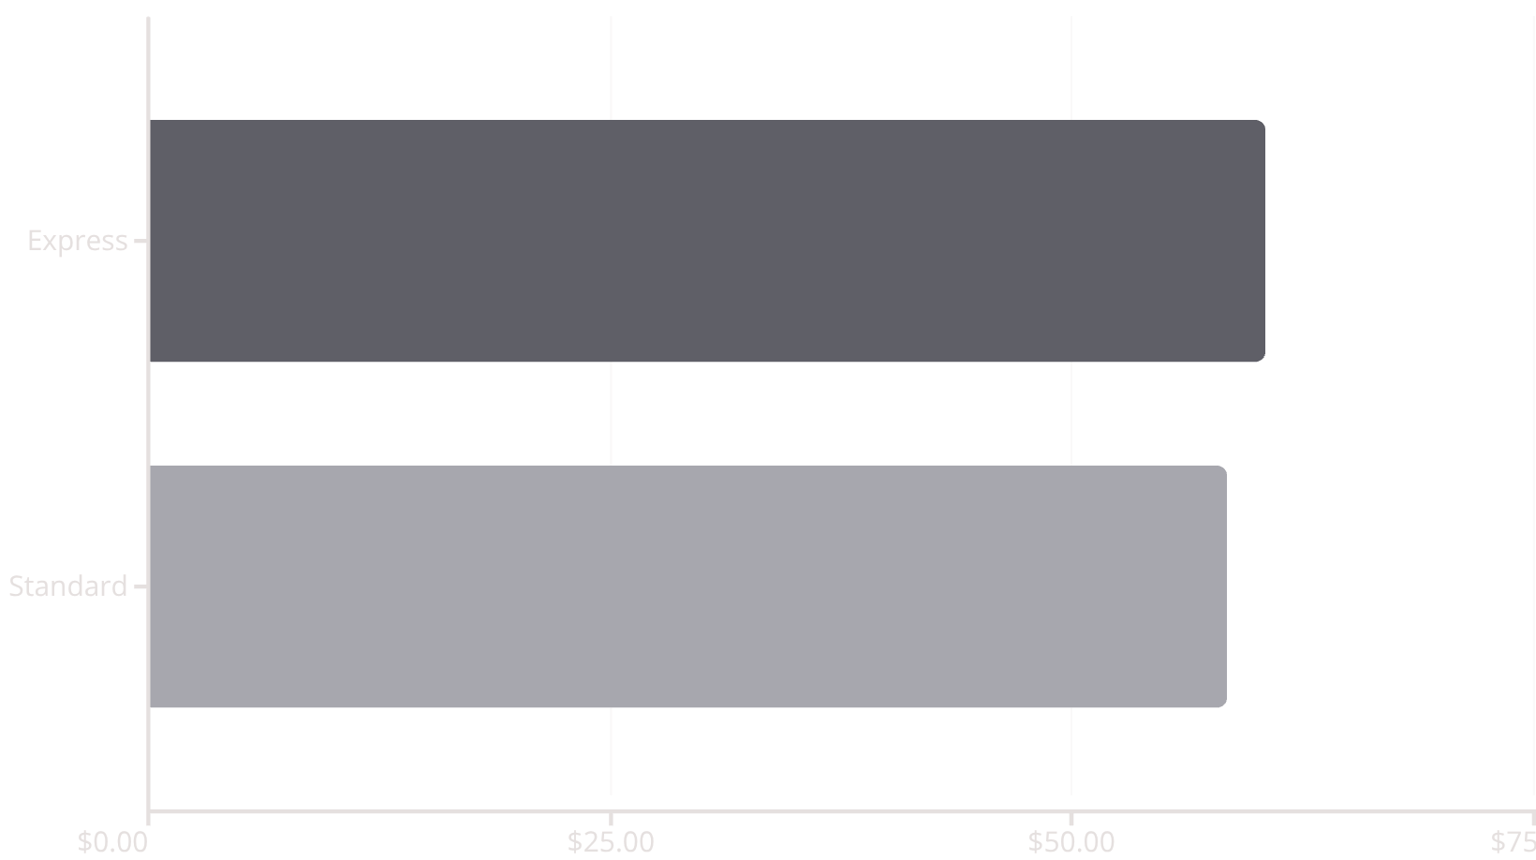
Shipping & Discount Analysis
Shipping Type Impact
High-Value Discount Users
839 customers used discounts but spent above $59.76 average
Discounts drive volume without sacrificing basket size

Slide 9
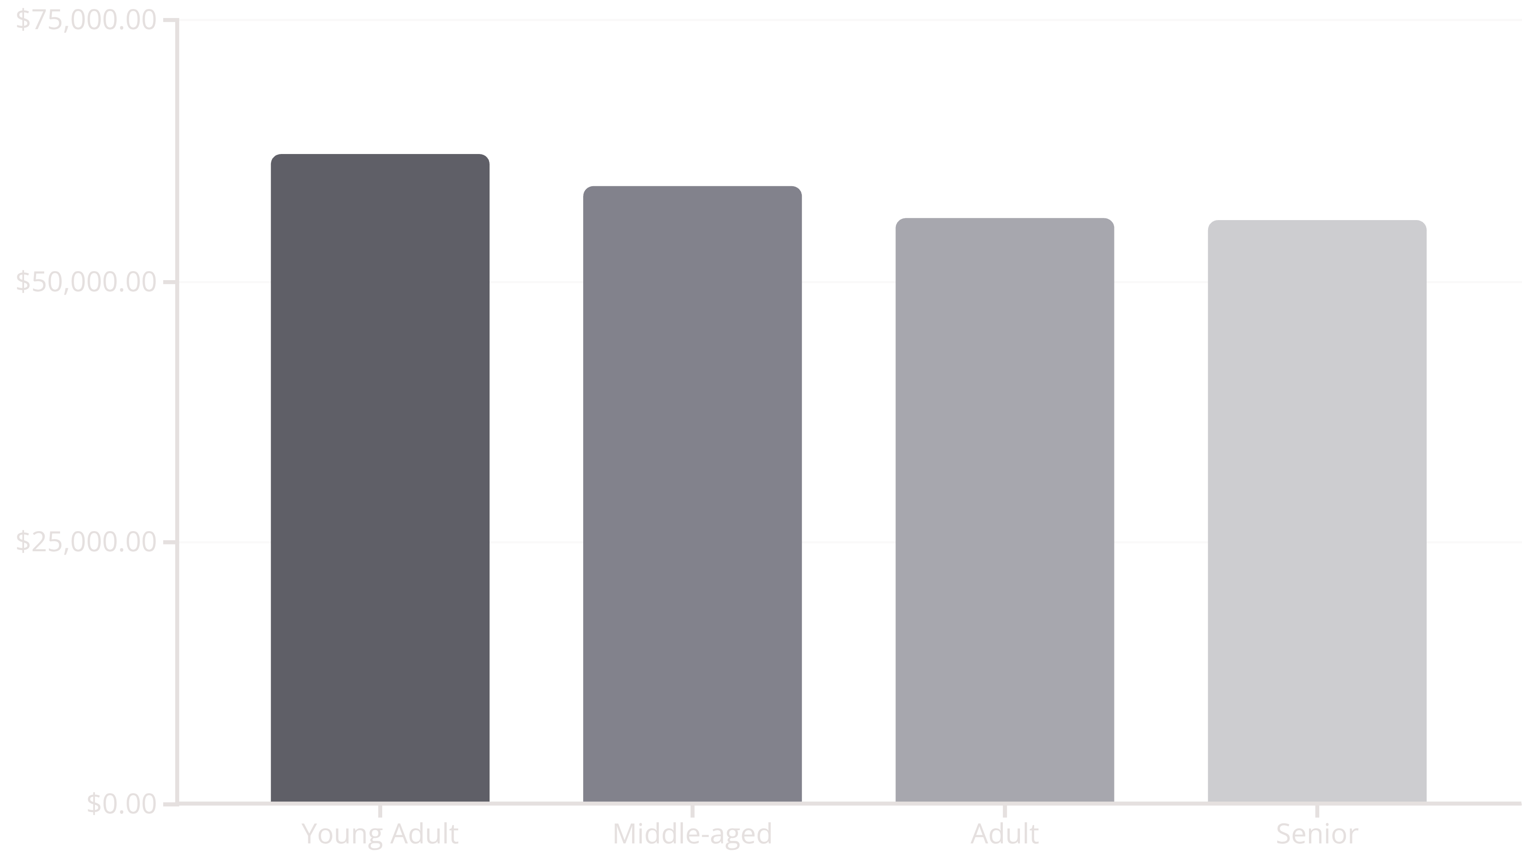
Revenue by Age Group
Young Adults lead revenue generation, followed closely by Middle-aged segment

Slide 10

Strategic Recommendations
Boost Subscriptions
Loyalty Programs
Review Discounts
Promote exclusive benefits to convert non-subscribers
Reward repeat buyers to grow Loyal segment
Balance sales boosts with margin control
Targeted Marketing
Product Positioning
Focus on high-revenue age groups and express shipping users
Highlight top-rated items in campaigns

